Slide 1


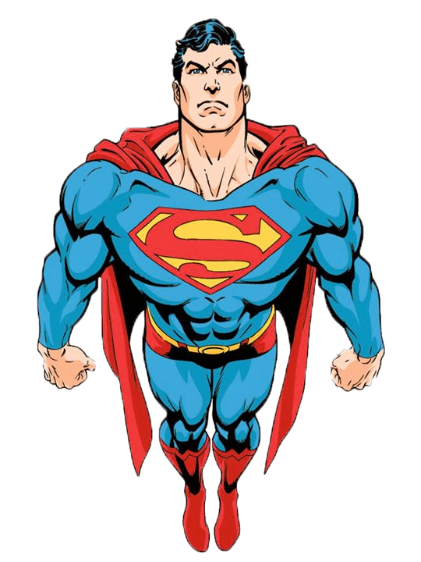

WebRTC
From Zero to Hero
The Rolling Scopes, 20.02.2016
Gabriel Mičko

Slide 2




@gabriel_micko
WebRTC From Zero to Hero
About me
Gabriel Mičko
DoclerHolding Front-end Developer Specialist
Mozilla Tech Speaker, Volunteer
@gabriel_micko
/gabriel.micko

Slide 3

@gabriel_micko
Plugin free video conferencing in the browser

Slide 4
@gabriel_micko
WebRTC From Zero to Hero
Web Real-TimeCommunication
Voice calling, Video chat, P2P File sharing
internal or external Plugin
meant to be rich, high-quality
browser, mobile platforms, and IoT devices
UDP transport layer
Secure (DTLS)

Slide 5
@gabriel_micko
WebRTC From Zero to Hero
WebRTC demo

Slide 6
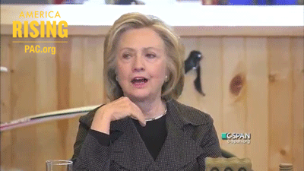
@gabriel_micko
WebRTC From Zero to Hero

Slide 7

@gabriel_micko
WebRTC From Zero to Hero
Who uses WebRTC
+10M Active users
Facebook
WhatsApp
Hangout (P2P)
Firefox Hello
Appear.in
Talky.io

Slide 8





@gabriel_micko
WebRTC From Zero to Hero
Desktop browser support

Slide 9

@gabriel_micko
WebRTC From Zero to Hero
Mobile browser support

Slide 10
@gabriel_micko
WebRTC From Zero to Hero
Mac OSX - IOS Safari
Build native WebRTC apps that communicate with browser that supports the WebRTC standard, such as Chrome, Firefox and Bowser.
focused on mobile platforms
free and Open-Source
cross-platform (IOS, Mac OS X, Android)
http://openwebrtc.org

Slide 11
@gabriel_micko
WebRTC From Zero to Hero
WebRTC code
for developers
…but before

Slide 12
@gabriel_micko
WebRTC From Zero to Hero
Session Description Protocol
Dating back to 90’s
String-based business card
Audio and video codecs
Network lookup
Computer data weight
Easy transportation
<key>=<value>\n

Slide 13
@gabriel_micko
WebRTC From Zero to Hero
WebRTC API
getUserMedia, which allows a web browser to access the camera and microphone and to capture media
RTCPeerConnection, which sets up audio/video calls
RTCDataChannel, which allow browsers to share data via peer-to-peer

Slide 14
@gabriel_micko
WebRTC From Zero to Hero
What is …
STUN, service for detecting your public IP
TURN, relay between 2 client if the P2P connection fails
ICE Candidate, provides information where the data is going to be exchanged
https://github.com/coturn/rfc5766-turn-server/

Slide 15


@gabriel_micko
WebRTC From Zero to Hero
WebRTC connection
Gabriel
Peter
?

Slide 16

@gabriel_micko
WebRTC From Zero to Hero
Login to signalling
Gabriel
Peter
Signaling

Slide 17
@gabriel_micko
Plugin free video conferencing in the browser
P2P
Create offer
Receive offer
Candidates
Candidates
Receive answer
Create answer
STUN
STUN

Slide 18
@gabriel_micko
WebRTC From Zero to Hero
Signalling is for sharing
RTCPeerConnection offer
RTCPeerConnection answer
ICE candidates

Slide 19
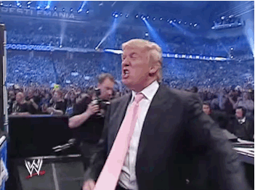
@gabriel_micko
WebRTC From Zero to Hero
Let’s code!

Slide 20

@gabriel_micko
WebRTC From Zero to Hero
Huh …

Slide 21

@gabriel_micko
WebRTC From Zero to Hero
Polyfill Adapter.js
https://github.com/Temasys/AdapterJS

Slide 22

@gabriel_micko
WebRTC From Zero to Hero
Streaming torrent client for node & the browser
https://webtorrent.io/
https://github.com/feross/webtorrent

Slide 23
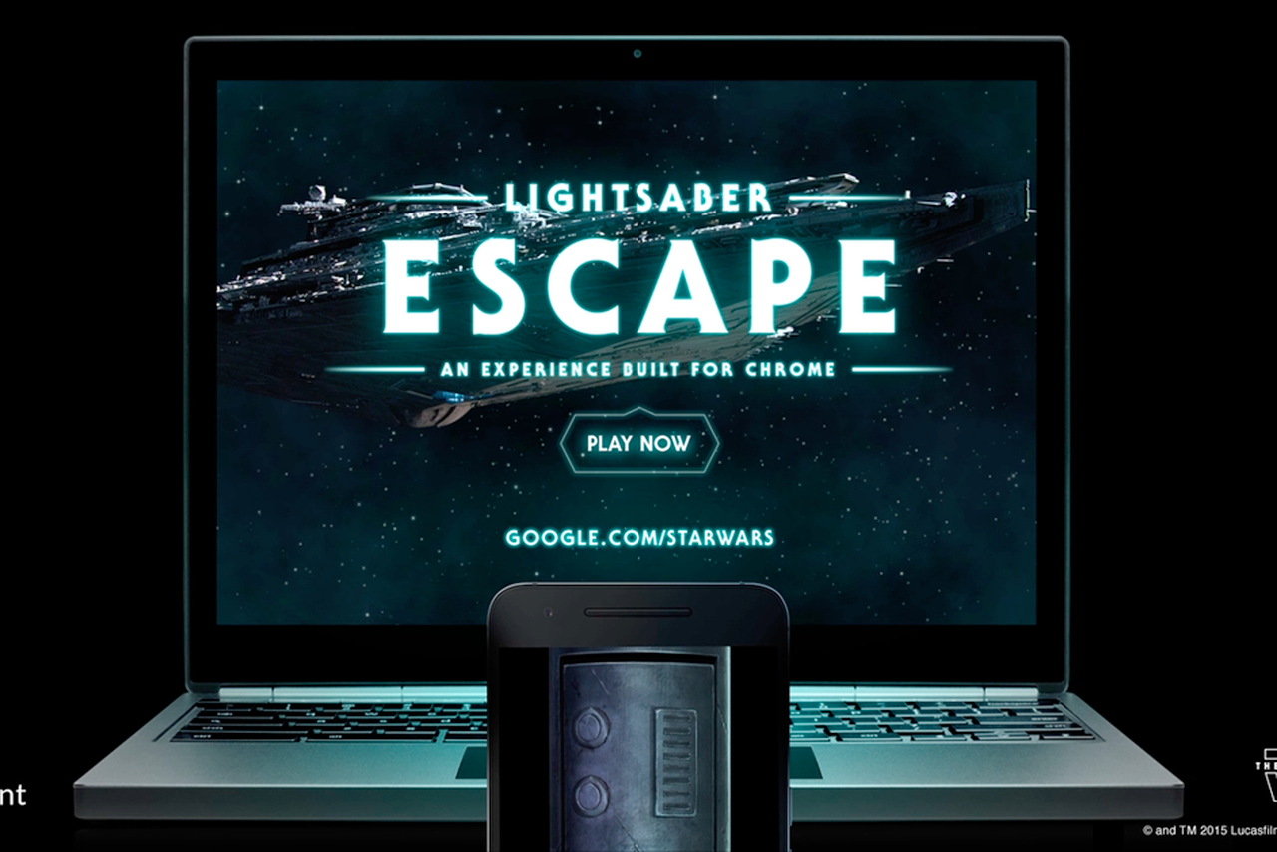
@gabriel_micko
WebRTC From Zero to Hero
http://google.com/starwars

Slide 24

@gabriel_micko
WebRTC From Zero to Hero
WebVR & WebRTC
Connect input devices from your desktop to your mobile phone with WebRTC.
https://proxy-controls.donmccurdy.com/demo

Slide 25
@gabriel_micko
WebRTC From Zero to Hero
WebRTC Multipoint control unit
https://jitsi.org/Main/Download
https://janus.conf.meetecho.com/
http://lynckia.com/

Slide 26
@gabriel_micko
WebRTC From Zero to Hero
Alliance for Open Media
Focusing on developing next generation media formats, codecs and technologies in the public interest.
Enough, lets go to standard
Open
Works for the web
Fits to any modem, device and bandwidth
Capable of streaming high quality real-time video
Amazon | Netflix | Microsoft | Intel | Cisco (Thor) | Mozilla (Daala) | Google (VP9)
http://aomedia.org/

Slide 27

@gabriel_micko
WebRTC From Zero to Hero
Object RTC
2015 -
http://ortc.org

Slide 28
@gabriel_micko
WebRTC From Zero to Hero
News around WebRTC
Canvas as the source of video stream
Screen sharing
Simulcast support
Duplex audio

Slide 29
@gabriel_micko
WebRTC From Zero to Hero
Is WebRTC ready yet?
http://iswebrtcreadyyet.com/
http://www.webrtc.org/
https://webrtcweekly.com

Slide 30
@gabriel_micko
WebRTC From Zero to Hero
Thank you.

Slide 31
@gabriel_micko
WebRTC From Zero to Hero
Questions?
Gabriel Mičko
@gabriel_micko
/gabriel.micko

